Slide 1

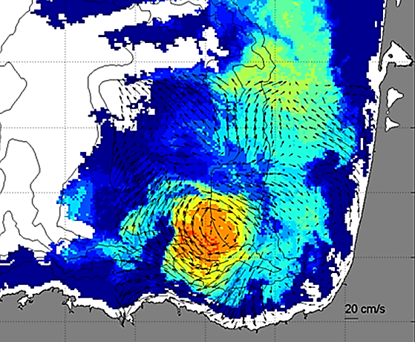
DAY 2 Session HF Radar in Europe
Paving the way to European HFR network in line with international efforts
CMEMS Service Evolution 21-SE-CALL1
Lot5: INCREASE project
Innovation and Networking for the integration of Coastal Radars into European mArine SErvices

Slide 2
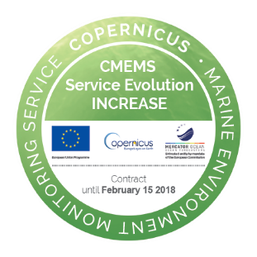
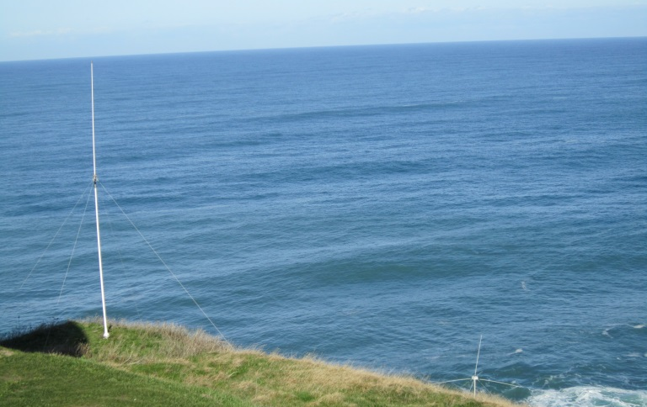

Paving the way to European HFR network in line with international efforts
Outline
    Relevance of HF Radars for CMEMS users
    Context in European HFR community
    EuroGOOS HF Radar Task Team
    Coordinated joint activities
    Potential transfer towards CMEMS 2018-2021
THE COPERNICUS MARINE WEEK
Brussels,
26 September 2017
DAY 2 Session
9:00-13:00
HF Radar in Europe
CMEMS Service Evolution 21-SE-CALL1
Lot5: INCREASE project
Innovation and Networking for the integration of Coastal Radars into European mArine SErvices

Slide 3
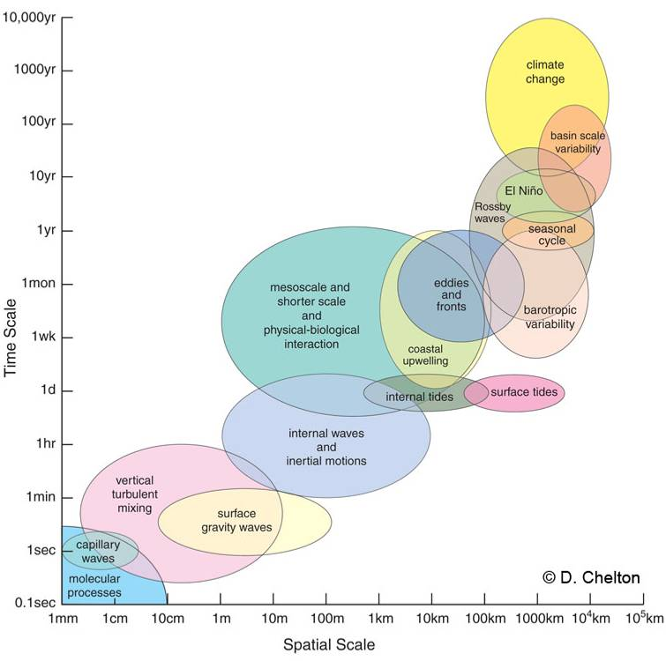
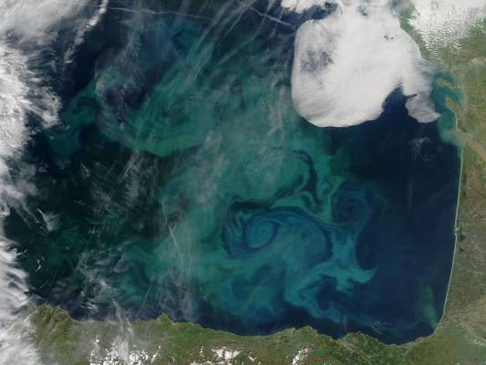
Paving the way to European HFR network in line with international efforts
1. Relevance of HF Radars for CMEMS users
The European HF Radar systems are playing an increasing role in the overall operational oceanography marine services.
High variability of spatial and temporal small scales of ocean processes.
Measurements in the ocean are limited, it is difficult to measure correctly (high time and space resolution & synoptic) the main ocean processes at mesoscale and shorter scales.
“Realistic” ocean models have been developed in the last decades to try to understand and forecast ocean motion. Need to validate them.
Mesoscale (50-500 km/ 10-100 days) is the dominant signal in the ocean (Le Traon and Morrow, 2001)

Slide 4
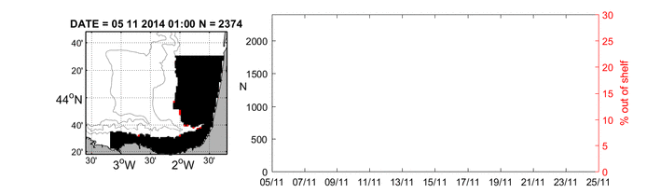

Paving the way to European HFR network in line with international efforts
1. Relevance of HF Radars for CMEMS users
From Regional User and Training Workshops → Need to improve the link between core services and downstream services, especially dedicated to the monitoring, surveillance and management of the coastal zone. One of the priority action suggested is the implementation of the observing and forecasting systems near the coasts.
The covered area allow a fundamental assessment in the buffer zone between Regional Marine Core services and downstream coastal tools.
  Typical surface current transport during winter in the SE Bay of Biscay
  Cross shelf transport by a winter anticyclone in the SE Bay of Biscay

Slide 5
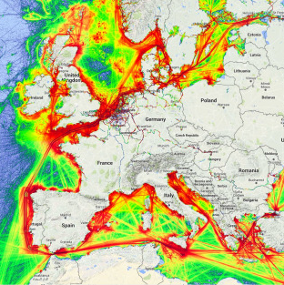
Paving the way to European HFR network in line with international efforts
1. Relevance of HF Radars for CMEMS users
Drivers in the coastal area
Source: Maritime traffic density in Europe, 2014, marinetraffic.com
Source: Mader et al. 2016; The European HF Radar Inventory

Slide 6

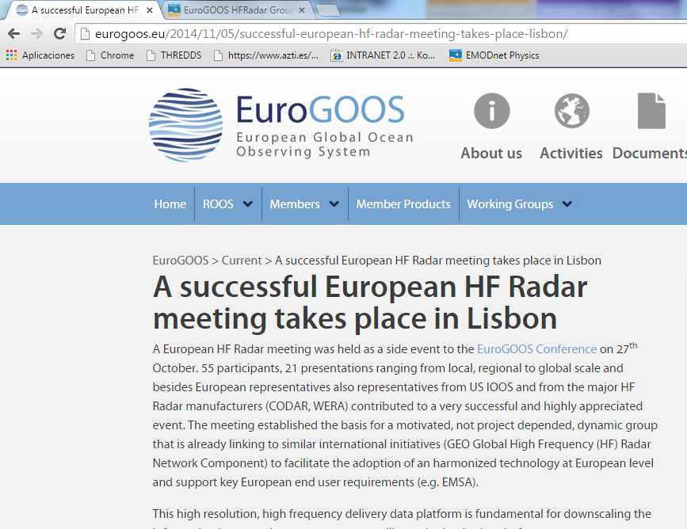
Paving the way to European HFR network in line with international efforts
2. Context in European HFR community
Significant heterogeneity still exists in Europe (concerning technological configurations, data processing, quality standards and data availability)
NETWORKING NEEDED TO ENSURE the accessibility to HF Radar data for a pan European use
Need of European coordination and networking for coastal HF radar community
Meeting Lisboa 27th October 2014
Side event EuroGOOS Conference → 54 participants
                3. Towards setting up the HFR Task Team
                2. Towards common European recommendations (from operators to end-users)
                1. Towards providing a framework for European HFR users

Slide 7
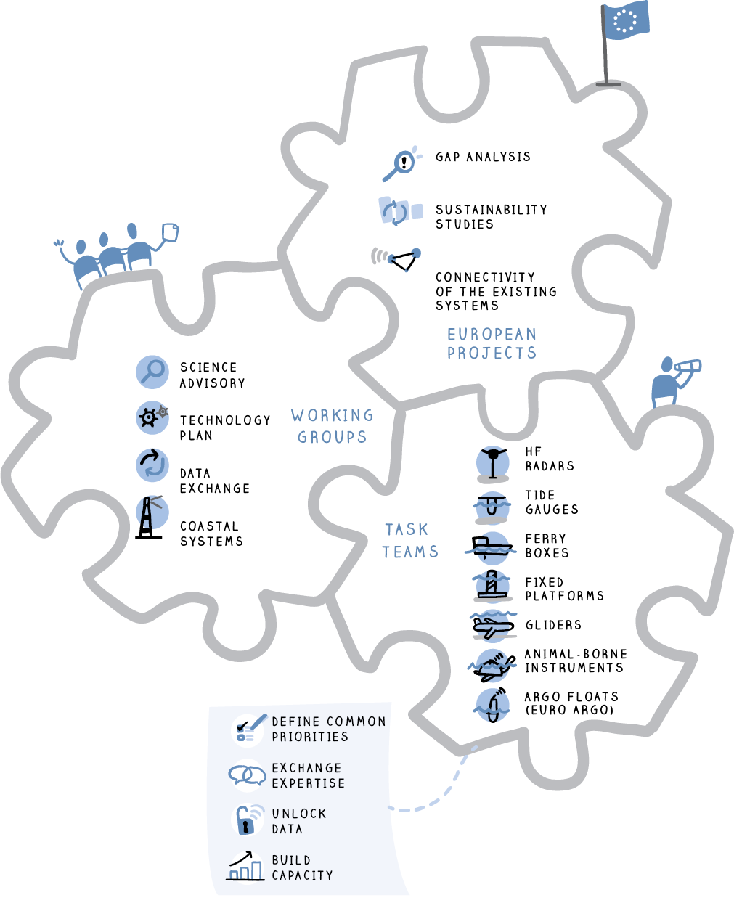
Paving the way to European HFR network in line with international efforts
2. Context in European HFR community
Strategies and actions are decided by an General Assembly and the Executive Directors
Actions are carried out by the EuroGOOS Office, the Board, the Chair and the members/partners.
Development of O.O. systems is carried out by the Regional Systems
Working groups produce strategies, priorities and standards for O.O.
Ocean Observing Task Teams organizes and develops the individual observation communities and foster cooperation

Slide 8
Paving the way to European HFR network in line with international efforts
3. EuroGOOS HF Radar Task Team
Benefits of a Task Team under EuroGOOS
Become part of a bigger community
Offers a permanent structure (not a project but will benefit from project funding)
Helps to raise awareness of European HF Radar activities
EuroGOOS Office assist in communication / coordination etc.
Enable links to similar initiatives and activities on the local, regional and global scales i.e. integration across networks/Task Teams
Attract funding –if well organized more likely to receive funding
Website showing an organized community and giving access to data (via the ROOSs and hence to EMODnet)
Common tasks -as a group- not individual institutes

Slide 9
Paving the way to European HFR network in line with international efforts
3. EuroGOOS HF Radar Task Team
i. Sustained observing system
EuroGOOS strategy Priorities 2016-2018
HF Radar Task Team Actions
Building an ocean observing system
A framework to enable funders, implementers and users to interact ensuring longer term sustainability
fully integrated into GOOS and GEOSS strategies for global coverage
Task Teams: set up a coordination mechanism to ensure a full alignment of the Task Team activities with the EuroGOOS strategies for EOOS and ROOSes.
Joint actions for network development (frequencies ITU, best practices, summer schools, etc)
Developing an important component of the ocean observing system: a unique insight to coastal ocean variability, by providing synoptic, high frequency and high resolution data at the ocean atmosphere interface → involved in key initiatives like JERICO-NEXT, EMODnet, CMEMS, SDC…
Enhancing the current potential of the European systems and planning the future
Creating community at operator level and at user level
Involved at Global level (GOOS and GEO)

Slide 10
Paving the way to European HFR network in line with international efforts
3. EuroGOOS HF Radar Task Team
ii. Data
EuroGOOS strategy Priorities 2016-2018
HF Radar Task Team Actions
Map the data availability in European regions
Real-time transmission: develop initiatives that increase the real-time delivery
Unlocking data sets
Enhancing and increasing Biogeochemical observations
Provide open access to data
Establish an interface with users of data (both end and intermediate users)
Performing (and updating) European HFR Inventory http://eurogoos.eu/download/publications/EU_HFRadar_inventory.pdf
Significant progress on standardization of Data format, control and distribution.
Allowing open access data in European data infrastructure
Focus on users (Data assimilation and model assessment, Marine Safety, Coastal and Marine Environment, Marine resources)

Slide 11
Paving the way to European HFR network in line with international efforts
3. EuroGOOS HF Radar Task Team
iii. Products
EuroGOOS strategy Priorities 2016-2018
HF Radar Task Team Actions
Production of fit for purpose products and services for end-users
Building collaborations with CMEMS, EMODnet, ICES, GEO, GOOS and other users
MSFD tailored products
User uptake: communicating with both users and producers
Development of advanced products (Data gap filling and refined grid products, Short term prediction, Lagrangian)
Working both at European level (JERICO-NEXT, EMODnet, CMEMS…) and between downstream services
MSFD: Environmental programs with strong hydrodynamic and transport monitoring components
Integration of HFRs with other observing technologies with wider horizontal (as the satellite remote sensing) and vertical coverage (as profilers, ADCPs in fixed stations or gliders)

Slide 12
Paving the way to European HFR network in line with international efforts
3. EuroGOOS HF Radar Task Team
iv. Communications Interface
EuroGOOS strategy Priorities 2016-2018
HF Radar Task Team Actions
Bridging the science/policy divide
Promotion of members activity
Assist member activities with communication plans
Wider Operational Oceanographic community: European leadership at global level
Outreach activities as a HFR European community (contents for EuroGOOS webpage, workshops, conferences, review paper, etc)
Supporting joint initiatives between European HFR actors
Working with EuroGOOS office for communication actions
Improve visibility of the European systems (Inventory, EMODnet Physics, …)
Involved at Global level (GOOS and GEO)

Slide 13
Paving the way to European HFR network in line with international efforts
3. EuroGOOS HF Radar Task Team
v. Cross-cutting activities
EuroGOOS strategy Priorities 2016-2018
HF Radar Task Team Actions
EC Projects and tenders
Task Teams: EuroGOOS retains the expertise to plan and prioritize the various platforms that make up the observing system
Advisory role
Communication
Assisting coordination and complementarities between different initiatives or projects
Wide participation of the HFR European community (HFR Task Team driven by a Core group with an extended list of associated actors)
Contribution into the EuroGOOS advisory role (EOOS workshops…)
Contribution into the EuroGOOS communication

Slide 14
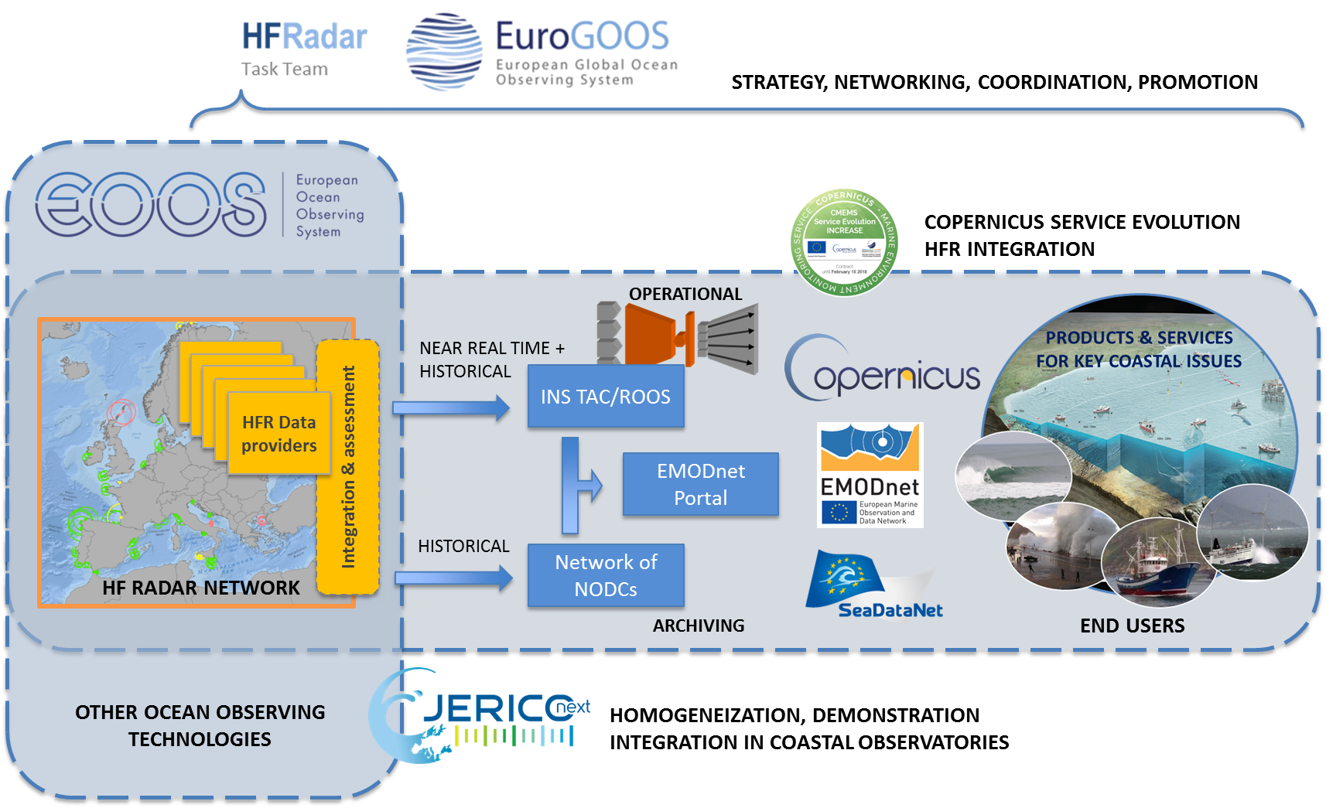
Paving the way to European HFR network in line with international efforts
4. Coordinated joint activities

Slide 15

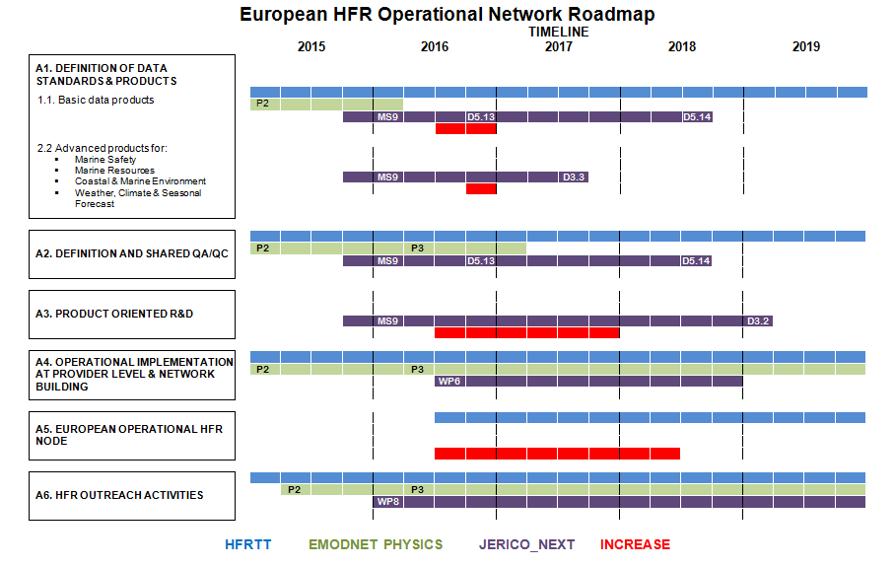
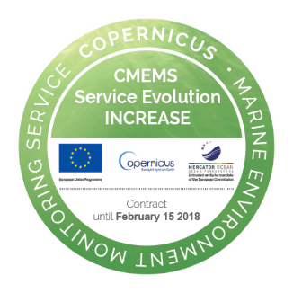


Paving the way to European HFR network in line with international efforts
4. Coordinated joint activities
Coordinated actions in JERICO-NEXT, INCREASE, EMODNET-Physics and SeaDataCloud that provide outputs and benefits for all the HFR community.

Slide 16
Paving the way to European HFR network in line with international efforts
4. Coordinated joint activities
HF Radar activities
WP2: Harmonisation of technologies and methodologies: technical strategy (NA)
Task 2.3: Harmonizing new network systems
Objective: Integrating HF-radar systems and cabled coastal observatories
WP3. JRA1- Innovations in Technology and Methodology
Objective: To improve the quality of current estimates and to integrate the surface information from HF radar with vertical information from the other components of the coastal observing system to improve 4D transport estimates.
Task 3.2 Developments on current observations from HF radars
WP4. JRA2- JERICO Valorisation through applied joint research
Task 4.4: JRAP #4 (hydrography): 4D characterization of trans-boundary hydrography and transport
WP5: Data management
Task 5.5: Coordinated implementation of Quality Assessment and Quality Control procedures for HF Radar data access
WP6: Virtual access
Objective: To provide free of charge “virtual access” to data and information that will enable scientists to carry out high quality research using data from a variety of coastal observation systems

Slide 17
Paving the way to European HFR network in line with international efforts
4. Coordinated joint activities
INCREASE tasks
WP1: Towards the integration of HFR observing technology into CMEMS
→ To bring CMEMS and HFR community closer
WP2: Basis for HFR data assimilation into CMEMS models
→ To bring information to modelers (CMEMS and CMEMS users)
WP3: HFR Products development
→ To perform show cases with HFR products
WP4: HFR Node
→ Paving the way towards a HFR Node
WP5: Coordination

Slide 18

Paving the way to European HFR network in line with international efforts
4. Coordinated joint activities
SeaDataCloud subtask
Integration of the HFR historical data into the SeaDataNet architecture:
Definition of standard interoperable data and CDI derived metadata formats for historical radial and total velocity data
Definition of QC standard procedures for historical radial and total velocity data, with particular focus on data versioning
Design and implementation of an open tool (to be run on the cloud architecture) for the conversion of native HF radar data (both radial and total velocity data) into the standard data and metadata formats and for the production of related CDIs
Implementation of prototype data access services for HF radar (e.g. OGC) in coordination with CMEMS

Slide 19

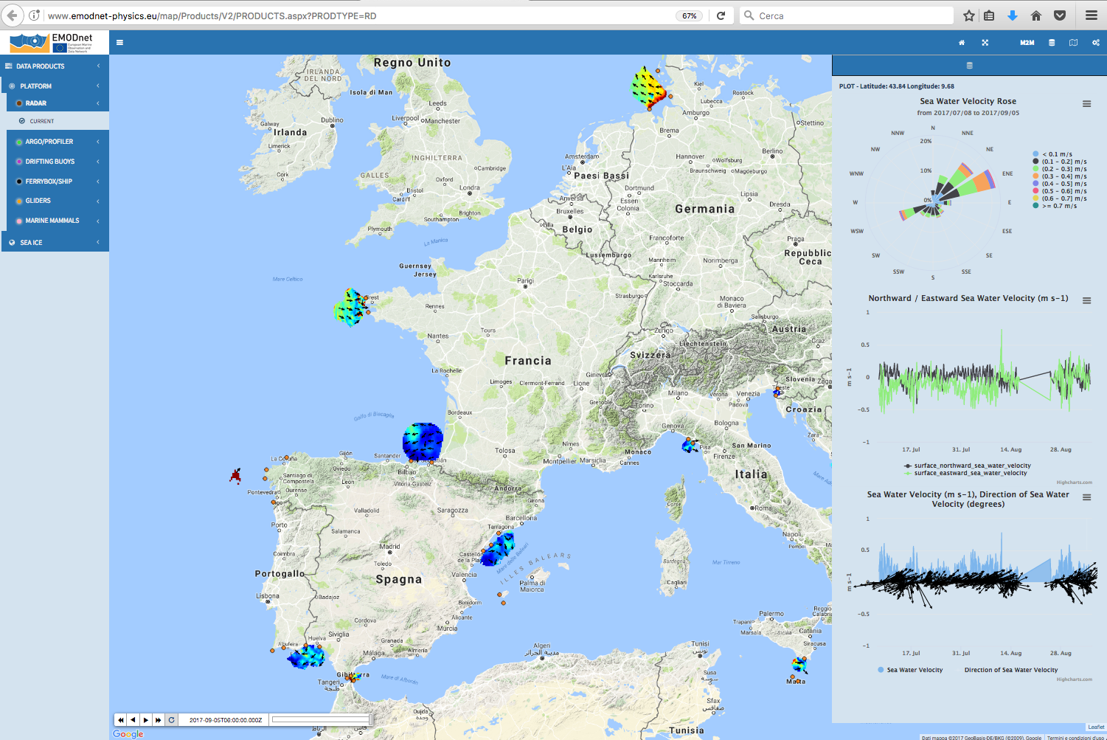
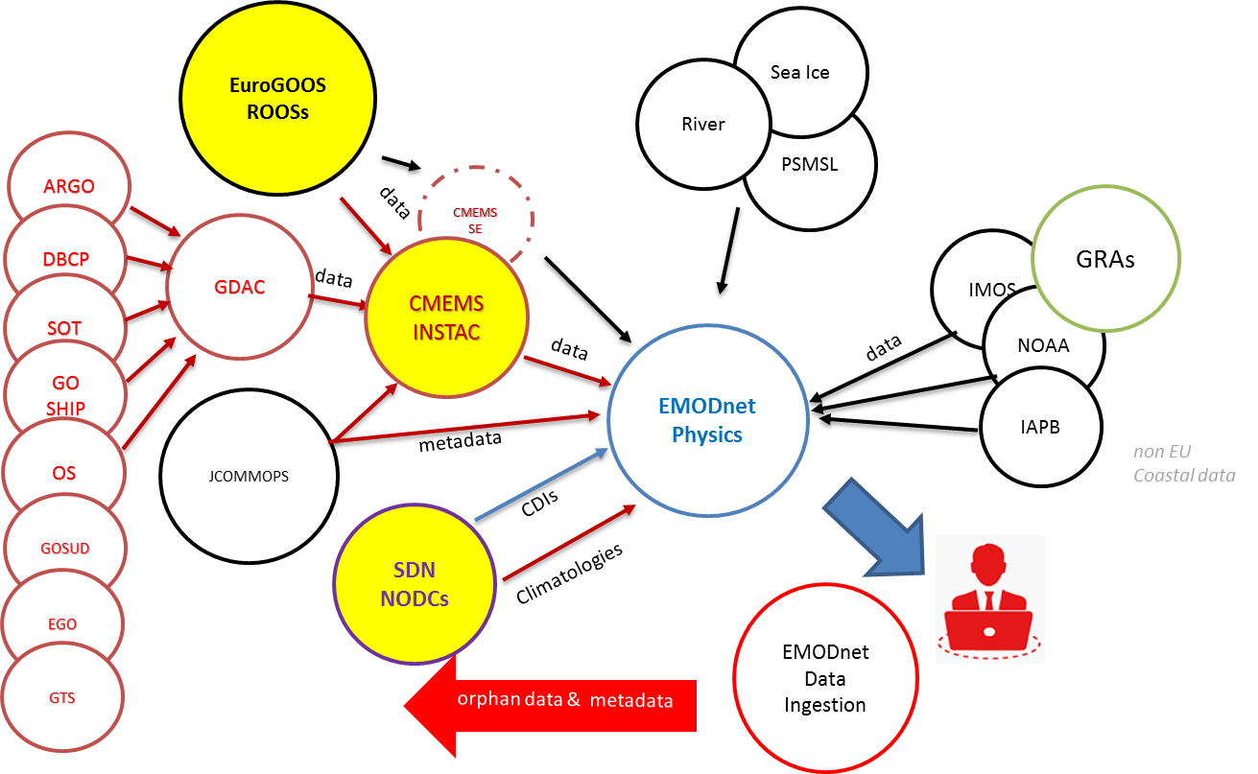
Paving the way to European HFR network in line with international efforts
4. Coordinated joint activities
EMODNET Physics³
Single point of access to an operational service where near real time and historical validated marine data and products are made interoperable and freely available
Connect additional monitoring systems (EMODnet Data Ingestion), make available additional products and strengthen the underlying operational and quality controlled data archives infrastructures (CMEMS INSTAC and EuroGOOS ROOSs, SeaDataNet NODC’s)
Develop interoperability and machine-to-machine connections to data and data products

Slide 20
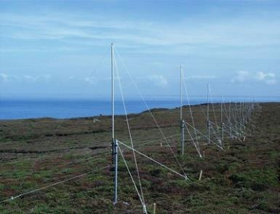
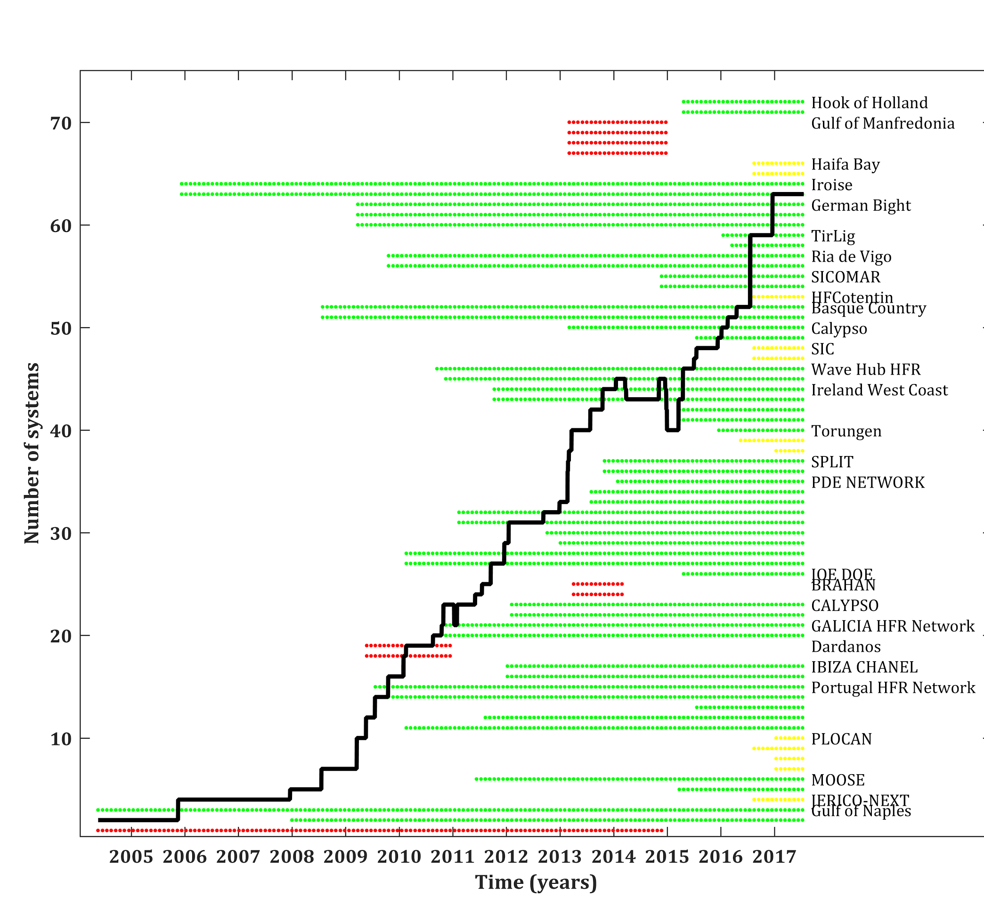
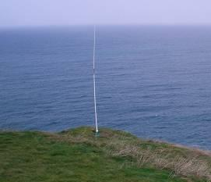
Paving the way to European HFR network in line with international efforts
5. potential transfer towards CMEMS 2018-2021
23 operators of ongoing or past HFR networks
72 sites (28 networks), 51 operational (20 networks).
Distribution of operational networks
50% (10 networks) in MONGOOS
30% (6 networks) in IBIROOS
20% (4 networks) in NOOS

Slide 21
Paving the way to European HFR network in line with international efforts
5. potential transfer towards CMEMS 2018-2021
Key new systems for the European Network (on going work)
The performed inventory of the operational HFR systems in Europe (Mader et al, 2016) includes 51 sites (in 20 networks) with potential impact in CMEMS. The MFC meshes overlap so one HFR station could impact in different MFC areas. The potential impact of the currently available data is distributed as follow: MED-MFC (17 stations), IBI-MFC (9 stations), NWS-MFC (3 stations). These numbers will grow at a mid/long term scale, because countries like Portugal, France or UK are establishing plans for developing their networks.

Slide 22
Paving the way to European HFR network in line with international efforts
Thank you for your attention!
http://eurogoos.eu/high-frequency-radar-task-team/
THE COPERNICUS MARINE WEEK
Brussels,
26 September 2017
DAY 2 Session
9:00-13:00
HF Radar in Europe
CMEMS Service Evolution 21-SE-CALL1
Lot5: INCREASE project
Innovation and Networking for the integration of Coastal Radars into European mArine SErvices

